Slide 1

Chapter 26
JavaFX

Slide 2
Chapter Scope
An introduction to JavaFX
The Java Scene Builder application
FXML files
JavaFX components

Slide 3
JavaFX
The JavaFX API is now the preferred infrastructure for Java GUIs and graphics
It will eventually replace Swing and the AWT
The development of JavaFX apps is facilitated by a standalone program called Scene Builder
It provides a drag-and-drop GUI generator, producing XML-based files called FXML

Slide 4
Hello, World in JavaFX
Let's look at a version of the Hello, World program in JavaFX
This program is not developed using JavaFX Scene Builder
There are no interactive controls (no event handling)
But it shows the basic structure of a simple JavaFX application

Slide 5
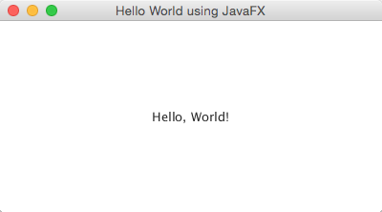
Hello, World in JavaFX
The program displays a window containing the Hello, World text:

Slide 6
import javafx.application.Application;
import javafx.scene.Scene;
import javafx.scene.control.Label;
import javafx.scene.layout.StackPane;
import javafx.stage.Stage;
/**
* Demonstrates a simple Hello, World program using JavaFX
* infrastructure. FXML is not used in this example.
*
* @author Java Foundations
*/
public class HelloWorld extends Application
{
/**
* Sets up a label and displays it in pane, scene, and stage.
* @param primayStage the primary stage for this application
*/
@Override
public void start(Stage primaryStage)
{
Label label = new Label("Hello, World!");
StackPane pane = new StackPane();
pane.getChildren().add(label);

Slide 7
Scene scene = new Scene(pane, 400, 200);
primaryStage.setTitle("Hello World using JavaFX");
primaryStage.setScene(scene);
primaryStage.show();
}
/**
* Launches the application. This method is not needed in some IDEs
* with strong JavaFX support.
* @param args the command line arguments
*/
public static void main(String[] args)
{
launch(args);
}
}

Slide 8
Hello, World in JavaFX
The class extends the JavaFX Application class
The start method is the entry point
The main method is only used to launch the app
In the start method, a Label is created, put into a pane, which is added to a scene, which is displayed on a stage (the window)
JavaFX embraces a theatre analogy

Slide 9
Hello, World in JavaFX
The pane in this example is a StackPane, which is an example of a layout container
A StackPane centers all of its content, which in this case is only the label
The primary stage (window) of the app is passed into the start method automatically

Slide 10
Using Scene Builder
The Hello World example was developed "by hand" - all controls and layout containers were created through explicit calls in the code
The JavaFX Scene Builder app lets you create GUIs by dragging-and-dropping components into a design area
Then you modify and style the components

Slide 11
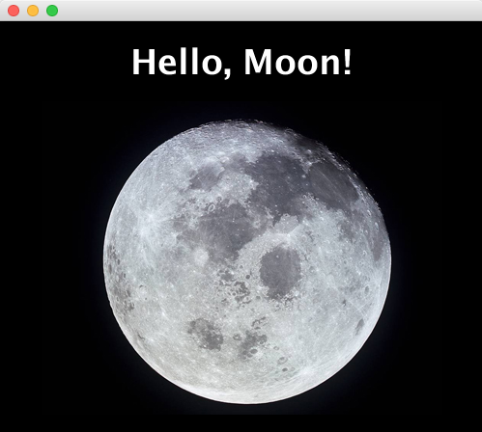
Using Scene Builder
We'll use Scene Builder to develop an app that displays an image and a label:

Slide 12
Using Scene Builder
Scene Builder saves the GUI as an FXML file
The development environment, such as NetBeans or Eclipse, uses the FXML representation to generate the GUI automatically
We'll use NetBeans in this example
The regular Java code makes references to the components represented in the FXML file

Slide 13
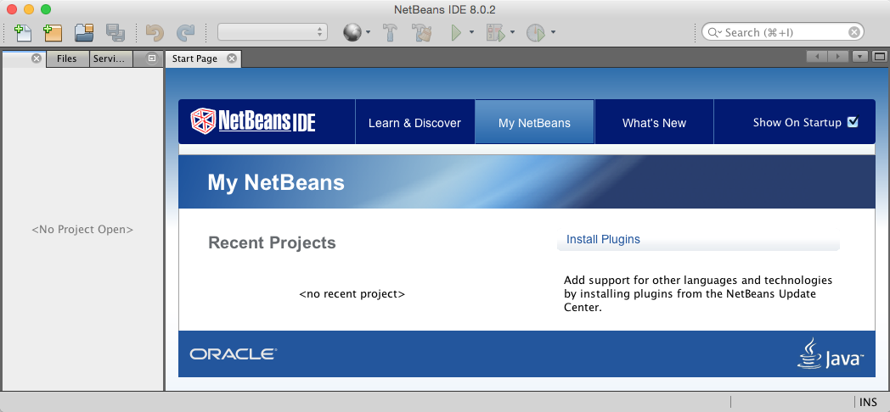
NetBeans and JavaFX
The NetBeans start page:

Slide 14
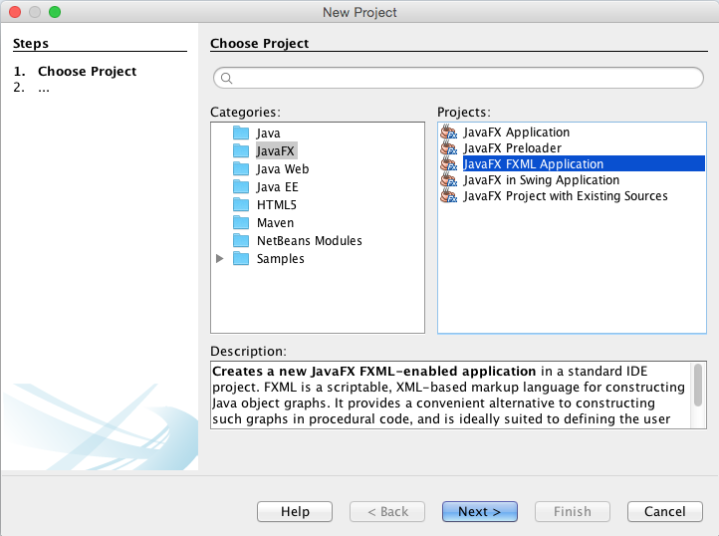
NetBeans and JavaFX
The NetBeans New Project window:

Slide 15
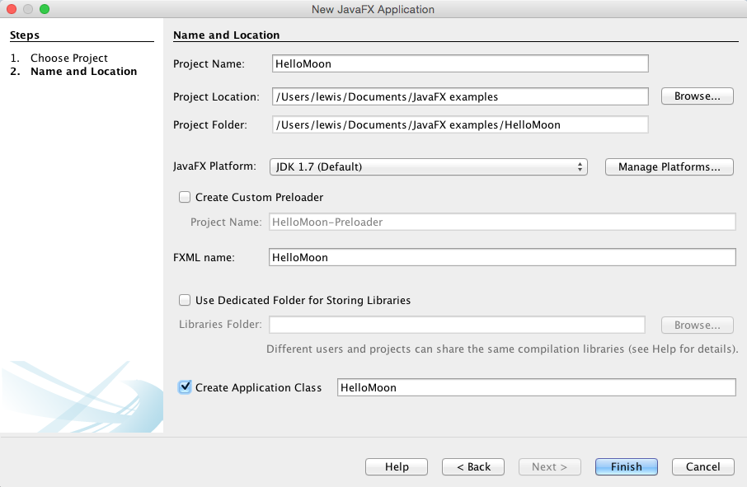
NetBeans and JavaFX
The NetBeans New JavaFX Application window:

Slide 16
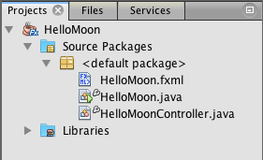
NetBeans and JavaFX
The Projects tab in the NetBeans window:

Slide 17
JavaFX App Files
The files created for this project:
HelloMoon.fxml – the FXML representation of the GUI
HelloMoon.java – the class that displays the GUI
HelloMoonController.java – the class that handles user events
Since this program is not interactive, the controller class is not needed

Slide 18
import javafx.application.Application;
import javafx.fxml.FXMLLoader;
import javafx.scene.Parent;
import javafx.scene.Scene;
import javafx.stage.Stage;
/**
* Demonstrates a JavaFX application that relies on FXML.
* @author Java Foundations
*/
public class HelloMoon extends Application
{
/**
* Loads the GUI from the FXML, sets the scene, and displays the
* primary stage.
* @param stage the primary stage for this application
*/
@Override
public void start(Stage stage) throws Exception
{
Parent root = FXMLLoader.load(getClass().getResource("HelloMoon.fxml"));
Scene scene = new Scene(root);
stage.setScene(scene);
stage.show();
}

Slide 19
/**
* Launches the application.
* @param args the command line arguments
*/
public static void main(String[] args)
{
launch(args);
}
}

Slide 20
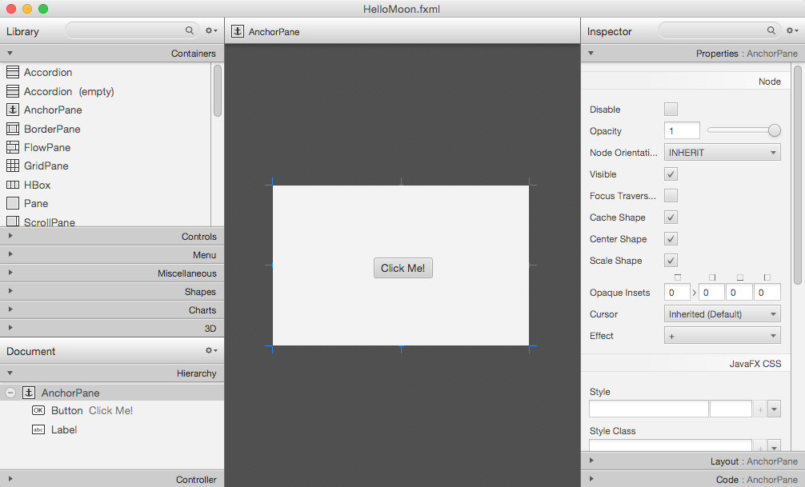
JavaFX Scene Builder
Scene Builder opens with a default interface containing a button:

Slide 21
JavaFX Scene Builder
The Library area (top left) contains elements you may want to drag into your interface
The Inspector area lets you style the elements you've added to the GUI
To create the Hello, Moon app, first delete the existing elements (button)
Then use a VBox layout pane as the root element, which lays out elements vertically

Slide 22
JavaFX Scene Builder
Style the VBox, setting its background color as well as its preferred width and height
Drag in a Label from the Library controls tab, then style it to be white text, bold, and 36 point
Finally, add the moon image by dragging an ImageView into the GUI
Use the inspector to specify the location of the moon image

Slide 23
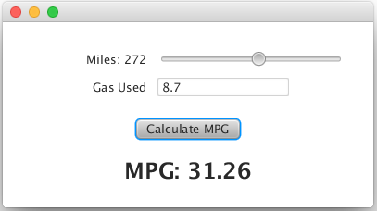
JavaFX Event Handling
Let's look at another example that uses interactive controls to calculate the miles per gallon for a trip:

Slide 24
JavaFX Event Handling
The class containing the start method will be similar to the others we've seen
This app will use the controller class to handle the events generated by the slider and button
It will use a combination of layout panes: a VBox for the overall layout and a GridPane to organize the labels, slider, and text field

Slide 25
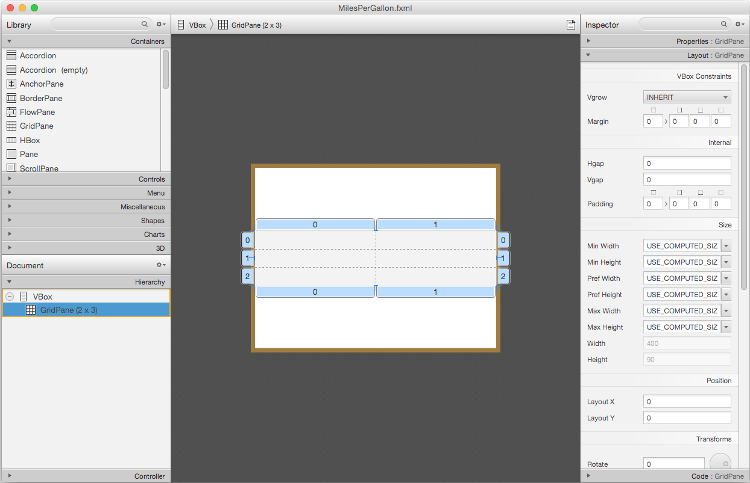
JavaFX Event Handling
A grid pane in JavaFX Scene Builder:

Slide 26
JavaFX Event Handling
The top labels and components are dragged into cells of the grid
The button and result label are dragged into the VBox (not the grid pane)
Each element is styled as appropriate
setting the min and max value of the slider
setting the slider initial value
etc.

Slide 27
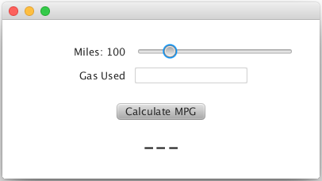
JavaFX Event Handling
The initial display of the program:

Slide 28
JavaFX Event Handling
To handle the user interaction, each component that must be referenced in the code must be given an fx:id (like a variable name) using Scene Builder
In the controller class, the variables labelled with the @FXL annotation correspond to the fx:id property
Not all elements need an fx:id

Slide 29
import javafx.beans.value.ChangeListener;
import javafx.beans.value.ObservableValue;
import javafx.event.ActionEvent;
import javafx.fxml.FXML;
import javafx.scene.control.Button;
import javafx.scene.control.Label;
import javafx.scene.control.Slider;
import javafx.scene.control.TextField;
/**
* The controller for the Miles Per Gallon program.
* @author Java Foundations
*/
public class MilesPerGallonController
{
private int milesTraveled = 100;
// Controls defined in the FXML file
@FXML
private Label milesLabel;
@FXML
private Slider milesSlider;
@FXML
private TextField gasTextField;

Slide 30
@FXML
private Button calculateButton;
@FXML
private Label resultLabel;
@FXML
private void calculateMPG(ActionEvent event)
{
double gasUsed = Double.parseDouble(gasTextField.getText());
double mpg = milesTraveled / gasUsed;
resultLabel.setText(String.format("MPG: %.2f", mpg));
}
public void initialize()
{
milesSlider.valueProperty().addListener(new SliderListener());
}

Slide 31
/**
* An inner class that serves as the listener for the slider.
*/
private class SliderListener implements ChangeListener<Number>
{
@Override
public void changed(ObservableValue<? extends Number> ov,
Number oldValue, Number newValue)
{
milesTraveled = newValue.intValue();
milesLabel.setText("Miles: " + milesTraveled);
}
}
}

Slide 32
JavaFX Event Handling
The initialize method is called when the GUI is loaded
The calculateMPG method should be called whenever the button is pushed
You set the OnAction event for the button in Scene Builder
SliderListener is defined as an inner class to update the miles traveled label as the slider is changed

